Slide 1
In Kindergarten

Slide 2
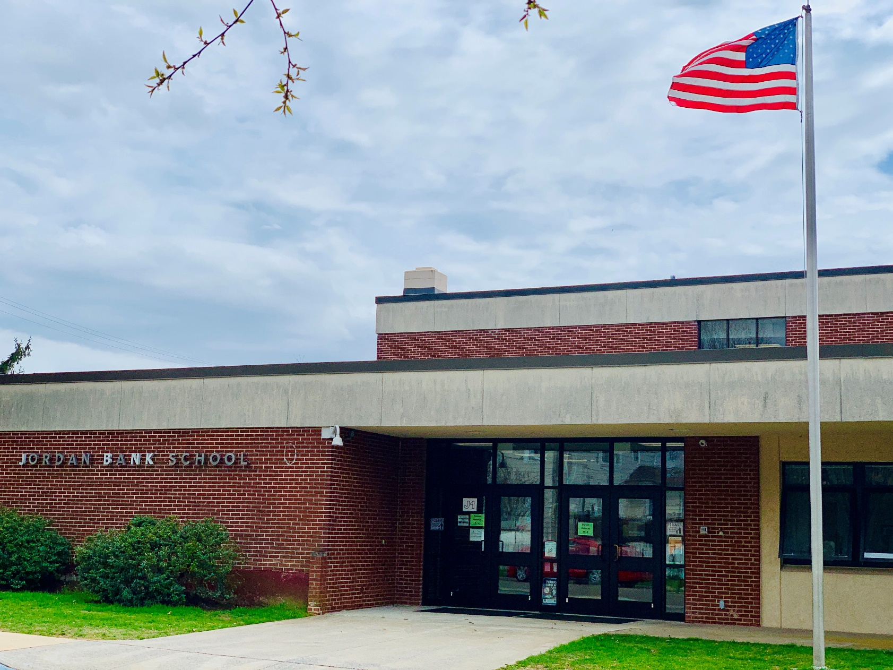
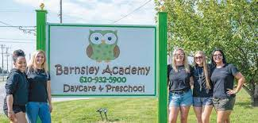
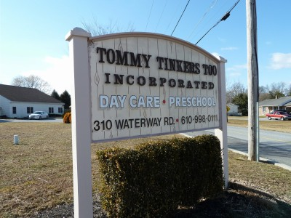
Partnerships & Transitions

Slide 4
Language Arts
Our Literacy program is myView- Savvas
Students are taught; phonics (letter sounds for reading and writing), phonemic awareness (rhyming and blending) high frequency words, reading themes (fiction, nonfiction, poems, myths, fairy tales), reading comprehension, reading skills, language and conventions

Slide 5
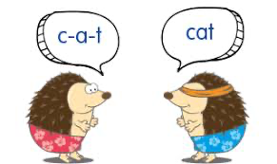
Language Arts
Our Daily phonological and phonemic awareness program is Heggerty
Students are taught; rhyme, phoneme isolation (initial, final and medial), blending words, segmenting, adding, deleting, and substituting syllables.

Slide 6
Language Arts
In writing, students are taught; how to label, write lists, write sentences about their lives, write “How to” sentences, write opinion sentences, write about non-fiction, write persuasive sentences, and poetry.
Our Handwriting program is building created.
Students are taught letter formation with consistent language throughout the school.

Slide 7
Math
Our Math program is Math in Focus
Students are taught; number names, counting, number sense, shapes, addition, subtraction, graphing and sorting

Slide 8
Social Studies
Our Social Studies Program is myWorld- Savvas
Student are taught; learning and working together, National and State symbols, how work is now and how it was long ago, geography of our neighborhood, time and chronology, and they learn about the past.

Slide 9
Science
Our Science program is Science Fusion
Students are taught; the senses, science skills, science tools, animals, plants, habitats, Earth’s resources, weather and seasons, matter, energy and motion

Slide 10
Assessments
We use the following to assess our student’s understanding:
-Dynamic Indicators of Basic Early Literacy Skills (DIBELS)
-Acadience Math Assessment
-Edmentum Exact Path
-Math Chapter Tests
-Educational Software for Guided Instruction (ESGI)

Slide 11
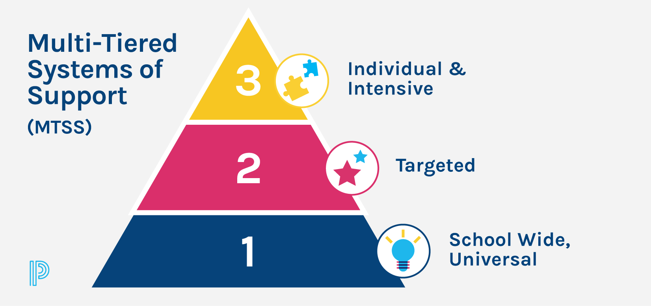
MTSS
Multi-Tiered Systems of Support
Meet monthly with Classroom Teachers to review classroom data and discuss student success and needs.
Meet monthly with the MTSS Team to review school wide data and discuss and implement supports for the school.

Slide 12
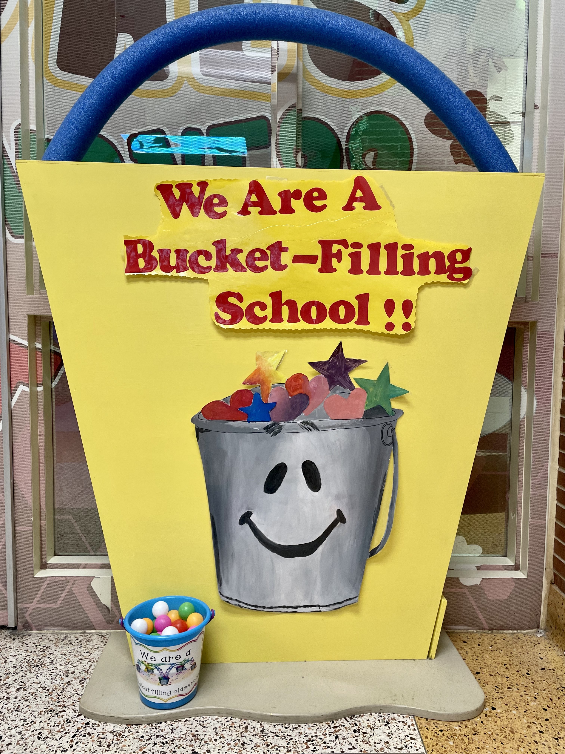
Social
Development
We use a school created Behavior Management System based on being responsible, being respectful, kind, honest, and always giving our best effort.
We use a Bucket filling reward system to help students become successful in school.

